Slide 1

CPU Scheduling

Slide 2
Fill in the blanks
A program in execution is called ----------- .
Interval between the time of submission and completion of the job is called
A scheduler which selects processes from secondary storage device is called…..
-------- system is used when there are rigid time requirements on the operation of processor.
The ------------- memory is a technique that allows the execution of processes that may not be completely in memory.
In ------- scheduling algorithm, a small unit of time, called time quantum, for each process.

Slide 3

Type of CPU Scheduling
CPU scheduling decisions may take place under the following four circumstances:
When a process switches from the running state to the waiting state (for I/O request or invocation of wait for the termination of one of the child processes).
When a process switches from the running state to the ready state (for example, when an interrupt occurs).
When a process switches from the waiting state to the ready state (for example, completion of I/O).
When a process terminates.

Slide 4
Type of CPU Scheduling
In circumstances 1 and 4, there is no choice in terms of scheduling. A new process (if one exists in the ready queue) must be selected for execution. There is a choice, however in circumstances 2 and 3.
When Scheduling takes place only under circumstances 1 and 4, we say the scheduling scheme is Non-preemptive; otherwise the scheduling scheme is Preemptive.
Running to Waiting
Running to Ready
Waiting to Ready
Process Terminate

Slide 5
Type of CPU Scheduling
Non-Preemptive Scheduling
Under non-preemptive scheduling, once the CPU has been allocated to a process, the process keeps the CPU until
Process is terminated
Switches to the waiting state.
Preemptive Scheduling
The resources (mainly CPU cycles) are allocated to the process for the limited amount of time and then is taken away, and the process is again placed back in the ready queue if that process still has CPU burst time remaining. That process stays in ready queue till it gets next chance to execute.

Slide 6
When preemptive scheduling is done:
High Priority Process Arrives
Times Slice Expires
Process completes it I/O Operation
Generate a child process

Slide 7
CPU Scheduling Criteria
Throughput: It is the total number of processes completed per unit time or rather say total amount of work done in a unit of time. This may range from 10/second to 1/hour depending on the specific processes.
Turnaround Time: It is the amount of time taken to execute a particular process, i.e. the interval from time of submission of the process to the time of completion of the process.
Waiting Time: The sum of the periods spent waiting in the ready queue amount of time a process has been waiting in the ready queue to acquire get control on the CPU.

Slide 8
CPU Scheduling Criteria cont…
Load Average: It is the average number of processes residing in the ready queue waiting for their turn to get into the CPU.
Response Time: Amount of time it takes from when a request was submitted until the first response is produced. Remember, it is the time till the first response and not the completion of process execution (final response).
In general CPU utilization and Throughput are maximized and other
factors are reduced for proper optimization.
CPU Utilization: To make out the best use of CPU and not to waste any CPU cycle, CPU would be working most of the time (Ideally 100% of the time).
Considering a real system, CPU usage should range from 40% (lightly loaded) to 90% (heavily loaded).

Slide 9
Shortest-Job-First (SJF) Scheduling
Out of all available (ready queue) processes, It selects the process with the smallest burst time to execute next.
  Preemptive
  Non-preemptive

Slide 10

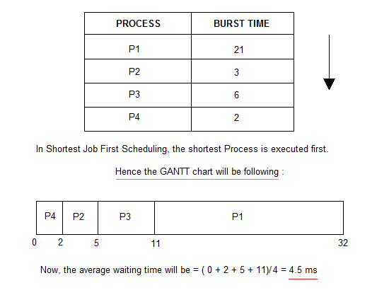
Q-1

Slide 11
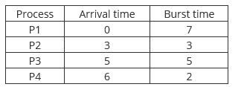
R-1
Consider the following CPU processes with arrival times (in milliseconds) and length of CPU bursts (in milliseconds) as given below: (GATE-2017)
If the pre-emptive shortest remaining time first scheduling algorithm is used to schedule the processes, then the average waiting time across all processes is _________ milliseconds.
Answer: 3

Slide 12
P-1
Which scheduling policy is most suitable for a time-shared operating systems?
(a) Shortest Job First (b) Round Robin
(c) First Come First Serve (d) Elevator
option (b)

Slide 13
P-2
Which of the following scheduling algorithms is non-preemptive?(GATE-2002)
(a) Round-Robin
(b) First In First Out
(c) Multilevel Queue Scheduling
(d) Multilevel Queue Scheduling with Feedback

Slide 14
P-3
Which of the following is false about SJF?
S1: It causes minimum average waiting time
S2: It can cause starvation
(A) Only S1
(B) Only S2
(C) Both S1 and S2
(D) Neither S1 nor S2 Answer
(D) S1 is true SJF will always give minimum average waiting time. S2 is true SJF can cause starvation.

Slide 15
P-4
Consider the following table of arrival time and burst time for three processes P0, P1 and P2. (GATE-CS-2011)
The pre-emptive shortest job first scheduling algorithm is used. Scheduling is carried out only at arrival or completion of processes. What is the average waiting time for the three processes? (A) 5.0 ms (B) 4.33 ms (C) 6.33 ms (D) 7.33 ms
Process | Arrival time | Burst Time
P0 | 0 ms | 9 ms
P1 | 1 ms | 4 ms
P2 | 2 ms | 9 ms

Slide 16
P-5
Consider the following set of processes, with the arrival times and the CPU-burst times given in milliseconds (GATE-CS-2004)
What is the average turnaround time for these processes with the preemptive shortest remaining processing time first (SRPT) algorithm ?
(A) 5.50 (B) 5.75 (C) 6.00 (D) 6.25
Process | Arrival time | Burst Time
P0 | 0 ms | 9 ms
P1 | 1 ms | 4 ms
P2 | 2 ms | 9 ms

Slide 17
Starvation and Aging
Starvation or indefinite blocking is phenomenon associated with the Priority scheduling algorithms, in which a process ready to run for CPU can wait indefinitely because of low priority. In heavily loaded computer system, a steady stream of higher-priority processes can prevent a low-priority process from ever getting the CPU.
Aging : Solution for increasing the time bound priority of processes

Slide 18
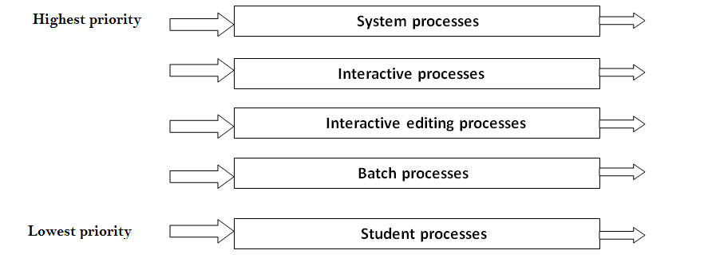
Multiple-Level Queues Scheduling

Slide 19
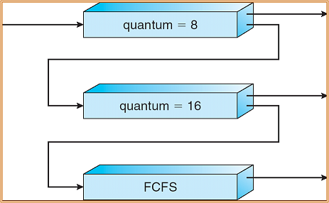
Multilevel Feedback Queues Scheduling

Slide 20
Multilevel Processor Queue scheduling

Slide 21
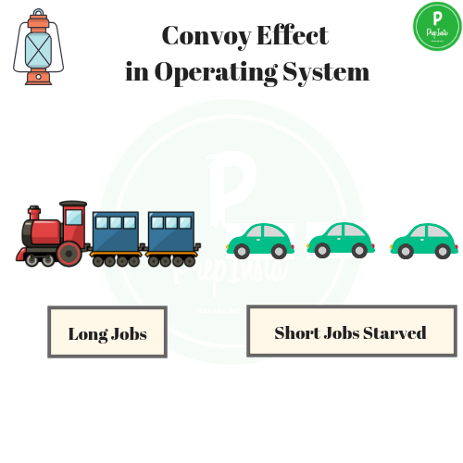
Name this phenomena?

Slide 22


